Slide 1
The Métis Rise Up
Social Studies 7

Slide 2
Areas of Focus
What issues did the Métis uprisings in the west raise for Canada?
In what ways did different ideas of citizenship shape events?

Slide 3
What do we already know?

Slide 4
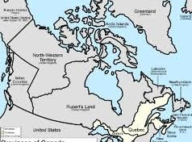
What Was the Red River Resistance?
Oct. 1869: people of Red River began to resist a plan of the HBC, Britain and Canada to transfer their region to Canada without consulting them.
April 1869: Canada buys Rupert’s Land and British-claimed territories in the northwest. (about $1.5 million today)

Slide 5
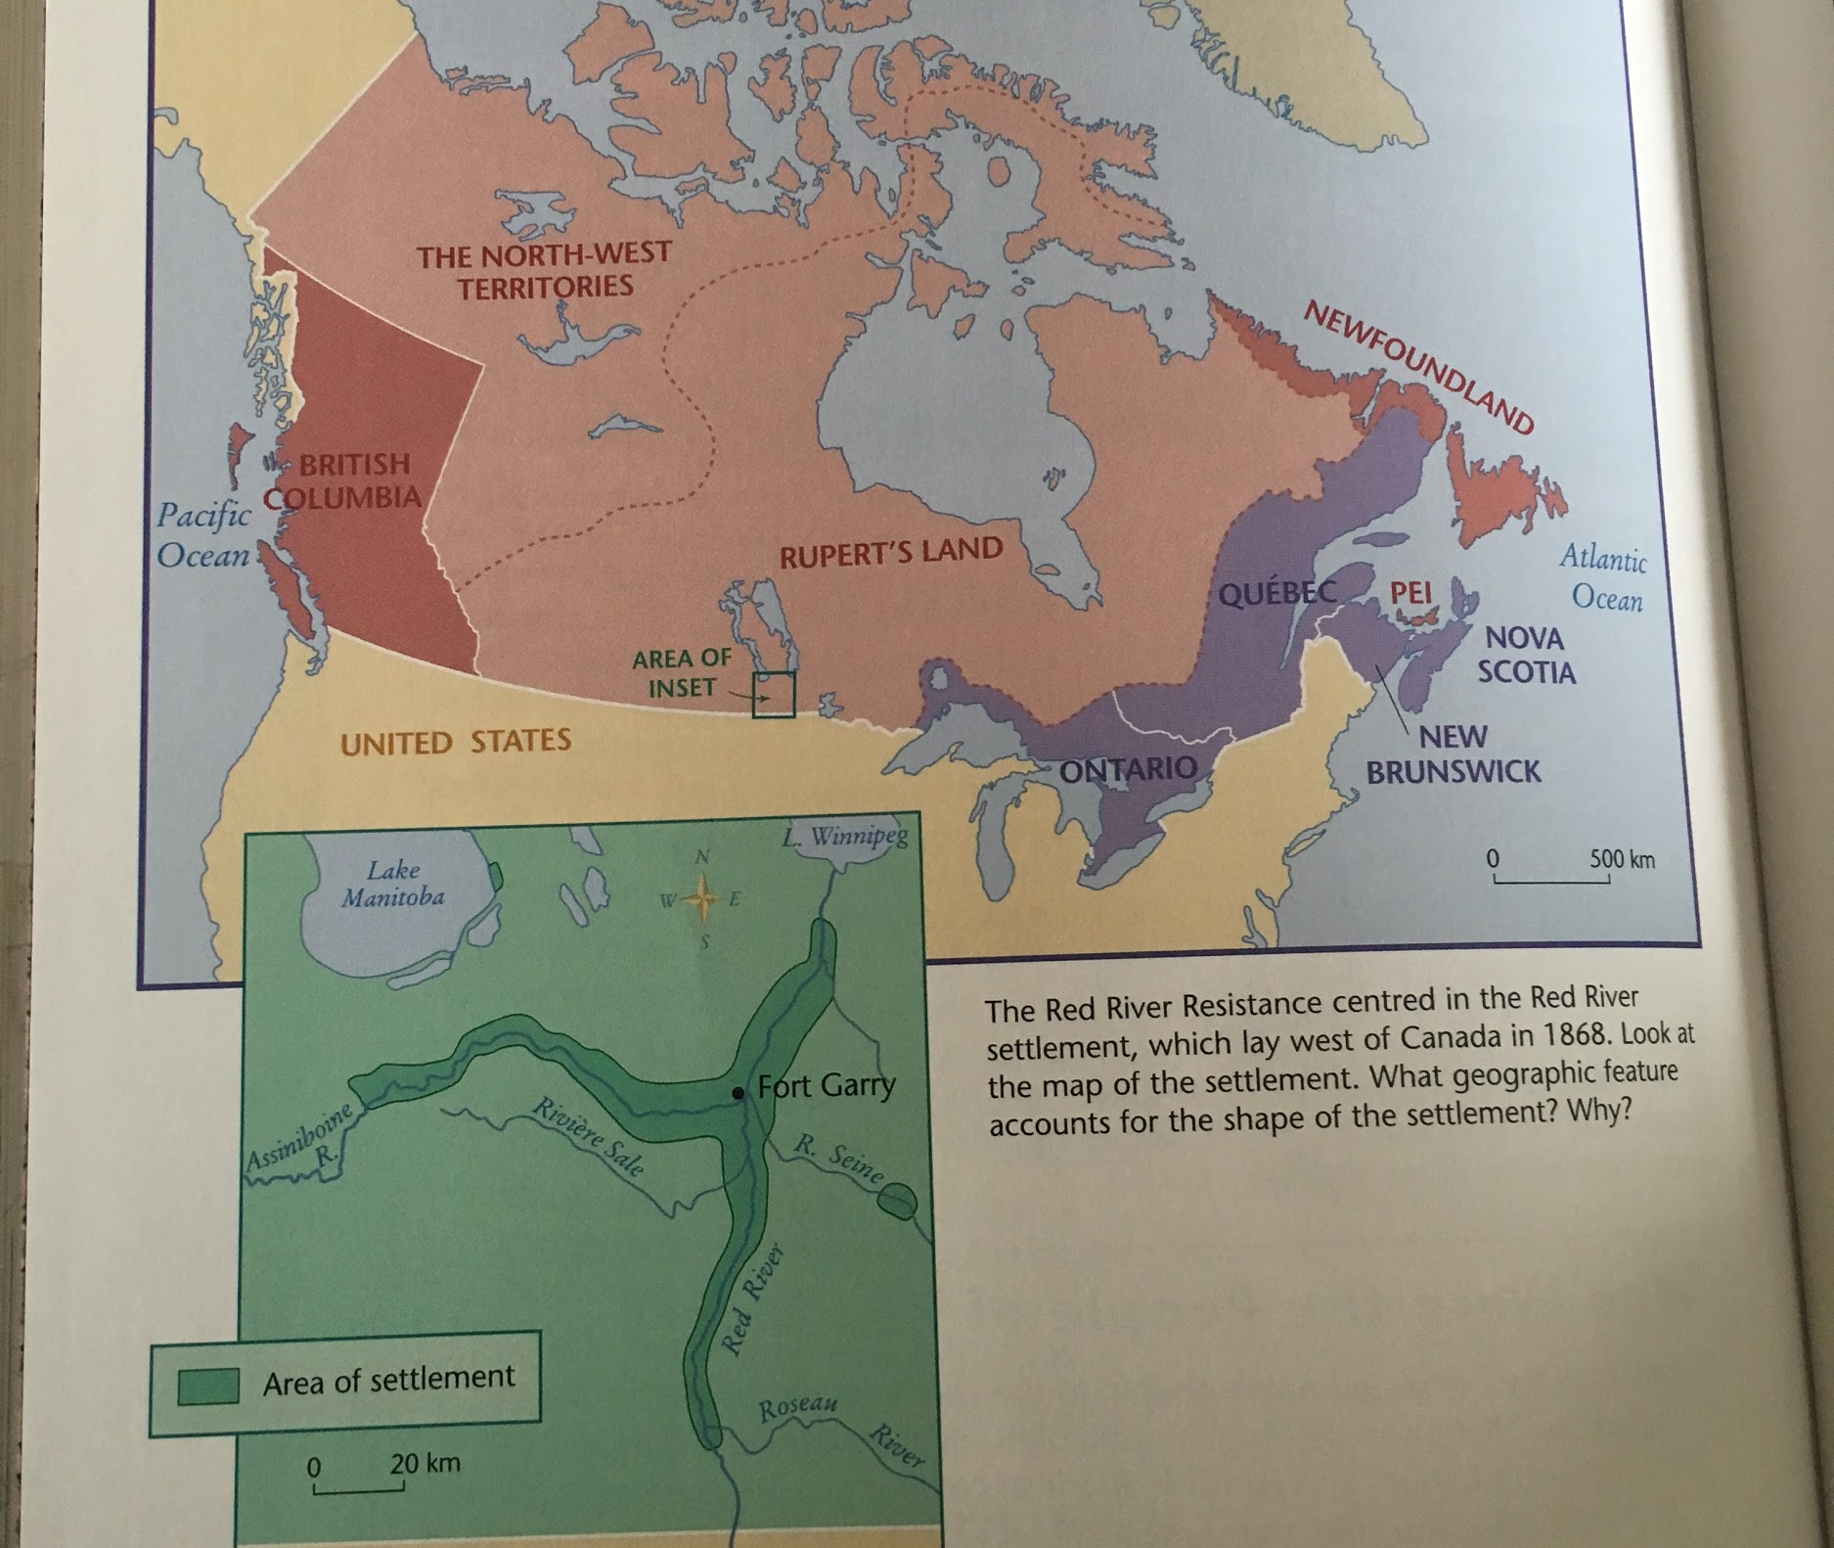
What Was the Red River Resistance?
Few of the people living in Rupert’s Land or the northwest territory were consulted about this decision.
The Metis people of Red River wanted a say in their future, but Canada intended to make their settlement part of a territory in which they would have little say.

Slide 6
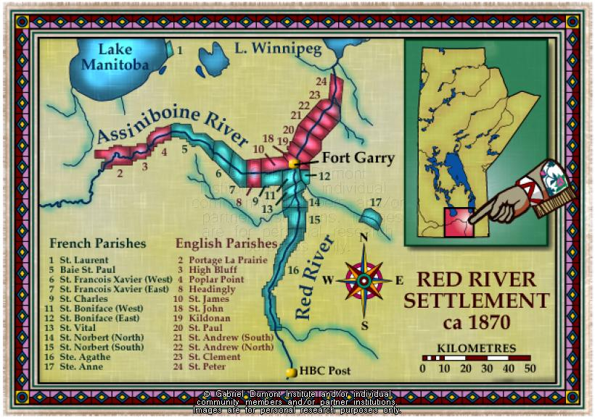
Who Were the People of Red River?
Francophone Metis
Anglophone Metis
Canadiens
Retired British HBC employees
Scottish and Irish colonists
By 1869, when the HBC transferred Rupert’s Land and the northwest to Canada, the majority of the people living at Red River were Metis.
About half of the population spoke French, and the other half spoke English.

Slide 7
What Triggered the Red River Resistance?
Dec. 1869: Red River faced many stresses:
Crop failure.
Buffalo decline.
Canada was making plans for Rupert’s Land and the northwest as if nobody was there.

Slide 8
What Triggered the Red River Resistance?
April 1869: Canadian surveyors in the area of Red River:
Measuring land into sections for settlement
This settlement would push the fur trade and the Metis way of life off the land.
Surveyors sometimes went right through the Metis farms as if they didn’t exist.

Slide 9
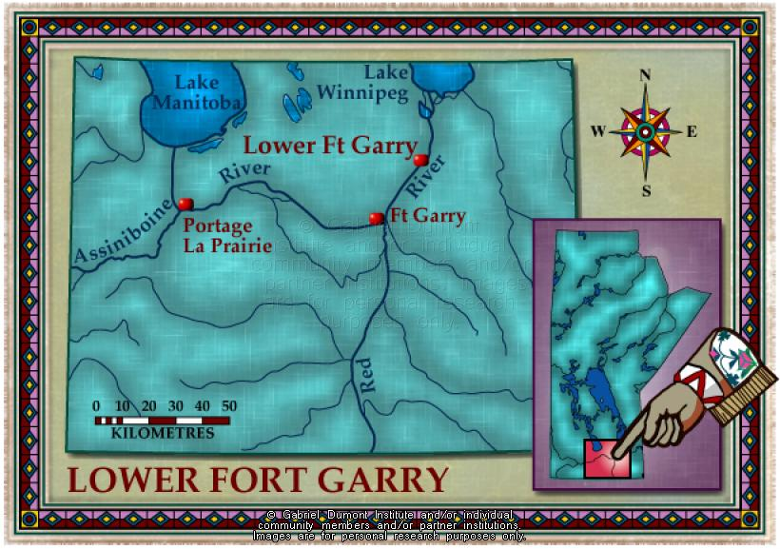
What Triggered the Red River Resistance?
November 1869: an official of Canada’s government tried to enter Rupert’s Land--William McDougall.
Canada had appointed McDougall lieutenant-governor of the territory and wanted him in Red River before the land transfer took place.
Metis volunteers set up a blockade and stopped McDougall.
The Metis took control of Fort Garry, the major HBC trading post in the area.
The HBC did not resist the capture of the fort, which took place without a shot fired.

Slide 10
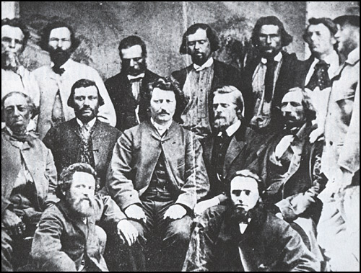
What Triggered the Red River Resistance?
Dec. 1869: Metis declared a provisional government at Fort Garry and issued the Declaration of the People of Rupert’s Land and the North-West.
Provisional government: a temporary government formed when no other authority can establish legitimate control
The members of the provisional government chose Louis Riel as president.

Slide 11
Let’s Do Some Thinking!
Think about what CITIZENSHIP means. What signals had Canada’s government given the people at Red River that they would not count as citizens in Canadian society? What are some examples?
In the declaration of the provisional government, what words and phrases challenge Canada’s government to rethink its idea of citizenship?
What words in the declaration describe Canada?
What words describe the population of Rupert’s Land and the northwest?

