Slide 1
Persuasive Writing
Humanities 7

Slide 2
Vocab Check!
What does the word ‘PERSUASIVE’ mean?
What does it mean when we try to PERSUADE someone?

Slide 3
“Cause (someone) to do something through reasoning or argument.”

Slide 4
What is PERSUASIVE WRITING??
Persuasive writing is a type of writing that tries to CONVINCE A READER OF AN OPINION OR BELIEF.

Slide 5
Why do authors try to persuade their readers?

Slide 6
Why?
To change their mind.
To support a cause.
To keep readers.
To make money.
To be best sellers.
To buy a product.

Slide 7
HOW do authors persuade readers?

Slide 8
How?
Free gift included.
Advertisements.
Humour.
Hollywood celebrity.
Tug at emotions.
Scare tactics.
Familiar things.
Favourite characters.

Slide 9
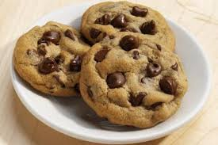
Let’s Discuss!
“Chocolate chip cookies are the best cookies!”
****DO YOU AGREE OR DISAGREE WITH THIS STATEMENT? WHY or WHY NOT? LIST 2-3 ARGUMENT WHY YOU AGREE/DISAGREE.

Slide 10
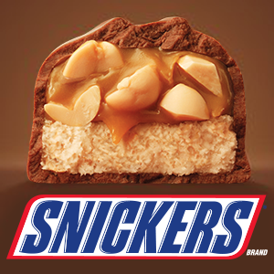
Let’s Discuss!
“Snickers bars are the worst kind of chocolate bar!”
****DO YOU AGREE OR DISAGREE WITH THIS STATEMENT? WHY or WHY NOT? LIST 2-3 ARGUMENT WHY YOU AGREE/DISAGREE.

Slide 11
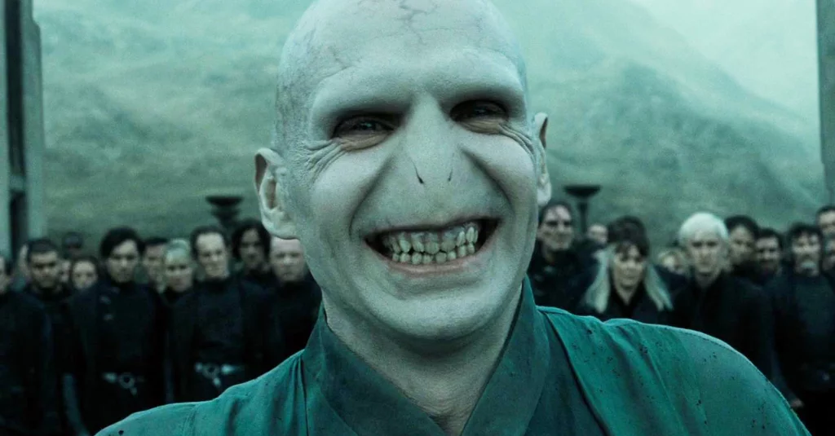
Let’s Discuss!
“Voldemort was a much more interesting character than Harry Potter!”
****DO YOU AGREE OR DISAGREE WITH THIS STATEMENT? WHY or WHY NOT? LIST 2-3 ARGUMENT WHY YOU AGREE/DISAGREE.

Slide 12
Let’s Discuss!
“The best hockey team in the NHL right now is the Edmonton Oilers.”
****DO YOU AGREE OR DISAGREE WITH THIS STATEMENT? WHY or WHY NOT? LIST 2-3 ARGUMENT WHY YOU AGREE/DISAGREE.

Slide 13
Let’s Discuss!
“If I could have one superpower, I would want the power of X-Ray vision!”
****DO YOU AGREE OR DISAGREE WITH THIS STATEMENT? WHY or WHY NOT? LIST 2-3 ARGUMENT WHY YOU AGREE/DISAGREE.

Slide 14
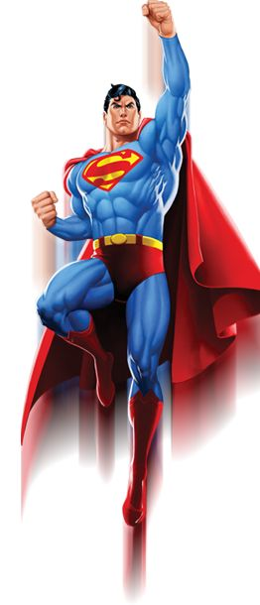
Building an Argument
I agree with the statement...
EXPLANATION: If I could have one superpower it would be X-Ray vision because…
It would allow me to see if there was danger around every corner.
EVIDENCE:
Superman

Slide 15
Argument vs. Evidence
Argument is BROAD.
→ X-Ray vision is the best superpower because it allows the superhero to see through physical barriers.
Evidence is SPECIFIC.
→ An example of the usefulness of X-Ray vision as a superpower can be seen with Superman. Superman had the ability to see through physical barriers, such as brick walls and doors. This allowed him to always be one step ahead of his enemies.

Slide 16
To what extent has Canadian identity been shaped by the past?
Analyze the source and demonstrate an understanding of what the source is saying.
Establish and argue a position in response to the question presented.
Support your position and arguments by using evidence from your knowledge and understanding of Social Studies.

Slide 17
Argument→ Explanation→ Evidence (Example) → Explanation→ Conclusion

Slide 18
Opinion
Reasons
Examples
Opinion

Slide 19
Persuade Me!
Using one of the following statements, complete the persuasive planning sheet that convinces me of your side!
“Chocolate chip cookies are the best cookies!”
“Snickers bars are the worst kind of chocolate bar!”
“Voldemort was a much more interesting character than Harry Potter!”
“The best hockey team in the NHL right now is the Edmonton Oilers.”

